Slide 1

Transport Layer
(TCP Congestion Control)
Lecture 6 | CSE421 – Computer Networks
Department of Computer Science and Engineering
School of Data & Science

Slide 2
Congestion Control Vs Flow Control
Congestion control try to make sure subnet can carry oﬀered traﬃc, a global issue involving all the hosts and routers.
  It can be open-loop based or involving feedback
Flow control is related to point-to-point traﬃc between given sender and receiver.
  it always involves direct feedback from receiver to sender

Slide 3
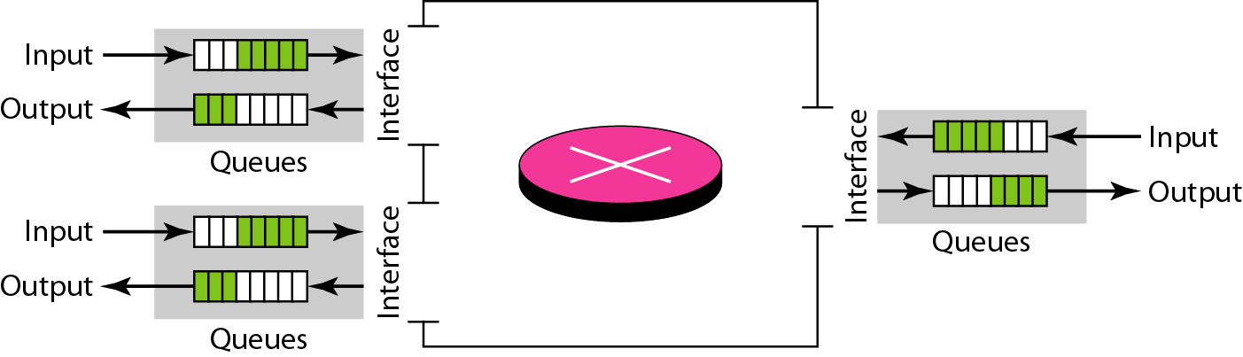
Congestion:
Congestion occurs
the load on the network > the capacity of the network
the number of packets a network can handle.
the number of packets sent to the network

Slide 4
Queues in a router
If packet arrival rate > the packet processing rate
  input queues becomes longer and longer
If packet departure rate < the packet processing rate
  output queues becomes longer and longer

Slide 5
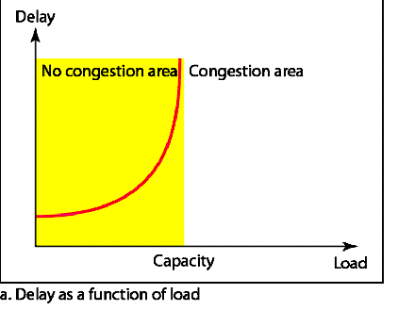
Network Performance
Delay has a negative effect on the load consequently the congestion.
When a packet is delayed, no ack for source, so source retransmits, making the delay and congestion worse.

Slide 6
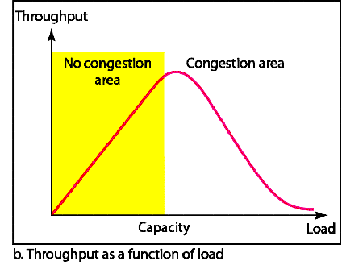
Network Performance
Why does the throughput sharply decline after the load reaches capacity instead of remaining constant?

Slide 7
Congestion Control
What is Congestion Control?
    mechanisms and techniques to control the congestion
    and keep the load below the capacity.
Two categories of Congestion Control
    Open Loop (Prevention)
    Closed Loop ( Removal)

Slide 8
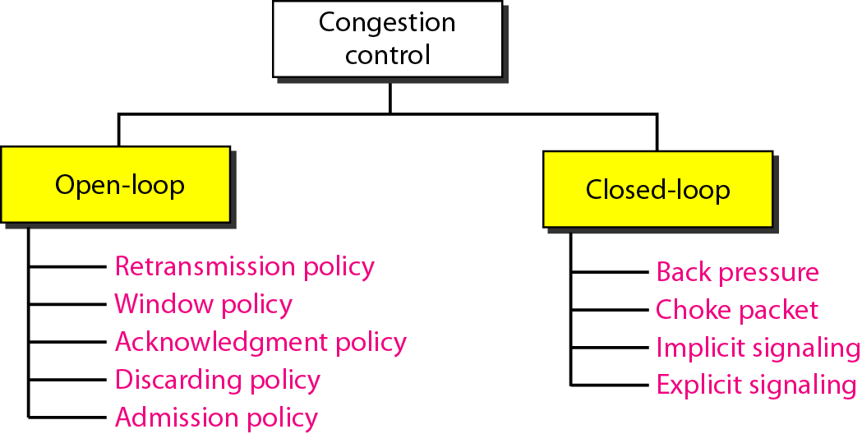
Congestion Control Categories

Slide 9
Open Loop Congestion Control

Slide 10
Open Loop Congestion Control
Retransmission /Window Policy:
    Retransmission in general increases congestion. (Example-later)
    Go-Back N ARQ window vs Selective Repeat window.
Acknowledgement Policy:
    Not acknowledging every packet slows down sender and helps prevent congestion.
    Acks are also part of the load in the network.

Slide 11
Open Loop Congestion Control
Discarding Policy:
    May choose to drop some packets
    A good policy by routers may prevent congestion and at the same time may not harm the integrity of the transmission.
Admission Policy:
    Check resource requirement before sending packet.
    Allow no new virtual circuits.

Slide 12
Closed Loop

Slide 13
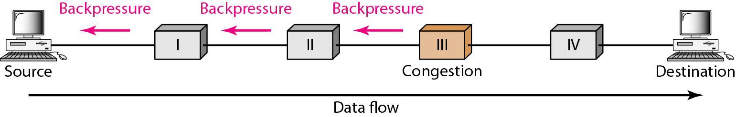
Backpressure
Congestion node stops receiving data from upstream nodes.
Upstream nodes may get congested, they in turn reject data from their upstream nodes.
Used in Virtual Circuits.

Slide 14
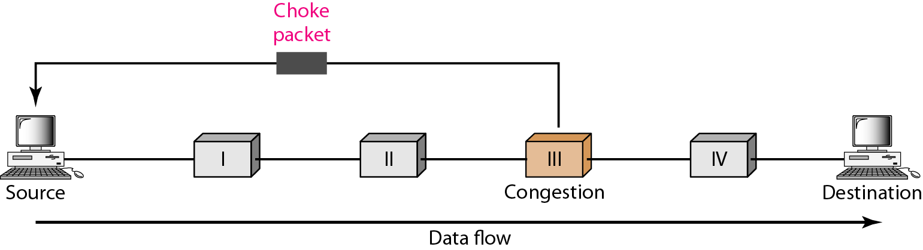
Choke packet
From a router to source directly.
Immediate nodes are not warned.
Example ICMP-source quench message. Immediate routers take no action.

Slide 15
Implicit Signaling
No communication between the congested node or nodes and the source.
Source guesses congestion by
  No acknowledgement for sent packets
  Delayed acknowledgements
Then source slows down.

Slide 16
Explicit Signaling
The node experiencing congestion sends signal to the source.
Not a separate packet like the “choke”packet.
Signal included in the data packet itself.
Can be
  Backward Signaling-Source warned, slows data
  Forward Signaling-Receiver warned, slows acks.

Slide 17
Congestion Control in TCP

Slide 18
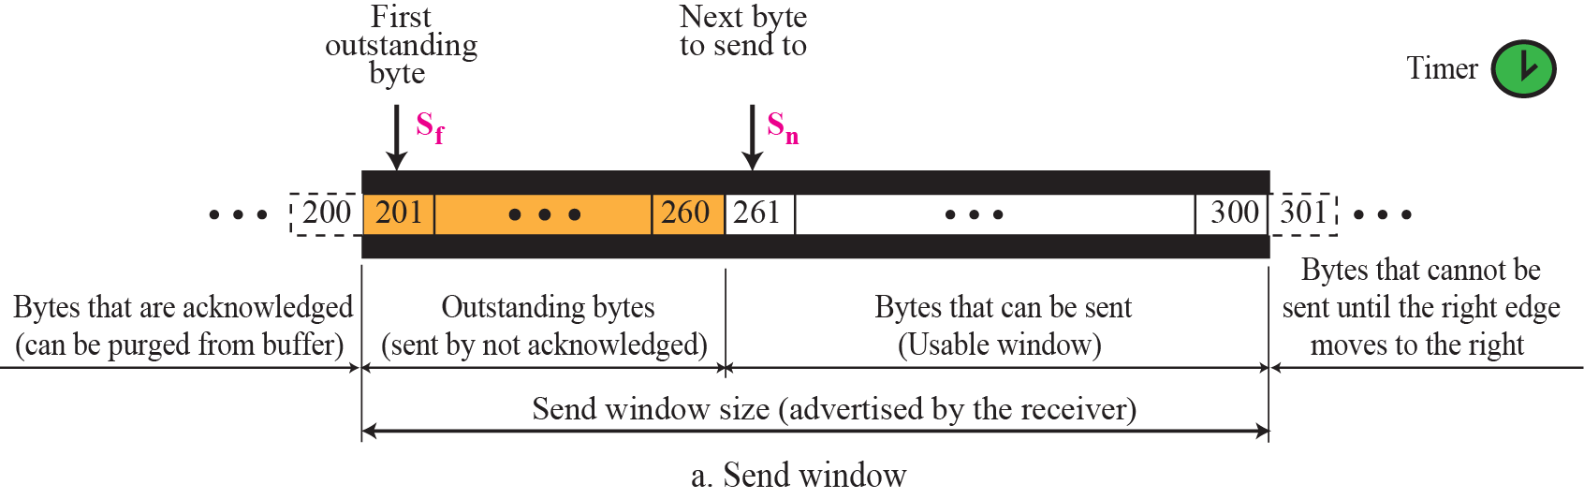
TCP Window – Sender Window (Review)
Sender Window Size is dictated by the receiver window.
Usually sender window size is determined by the available buffer space in the receiver (rwnd).

Slide 19
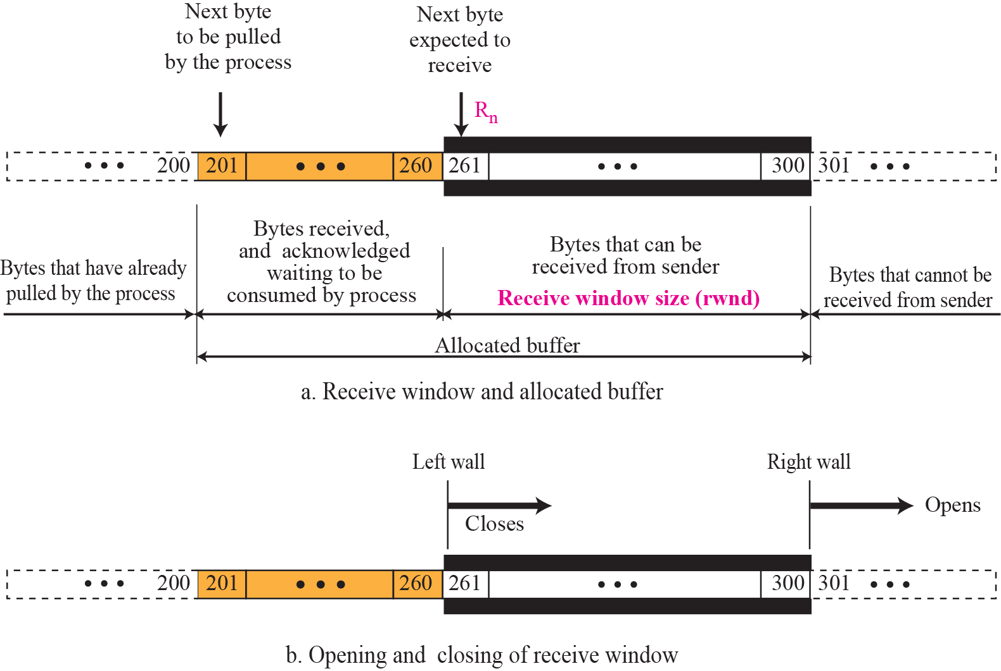
TCP Window – Receiver Window (Review)

Slide 20
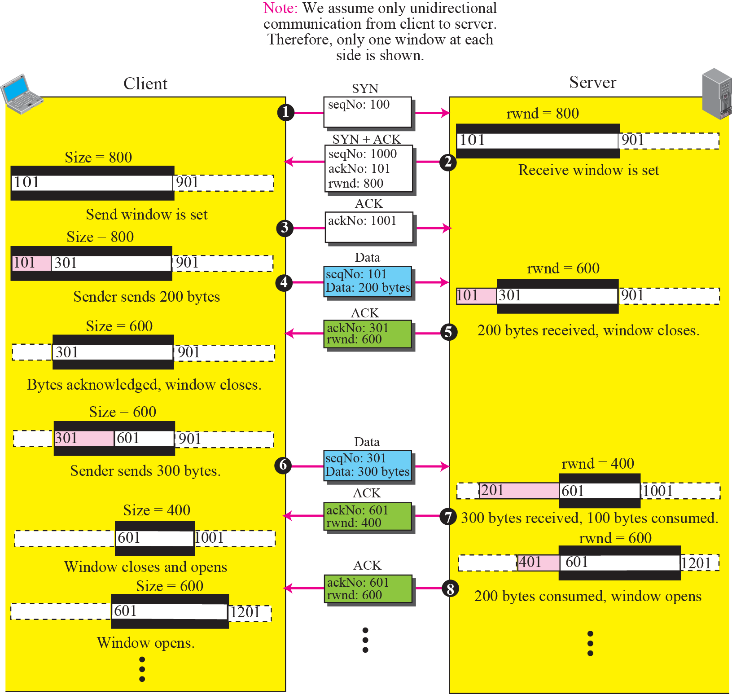
Normal Flow Control (Review)

Slide 21
TCP Window
Today, TCP protocols include that the sender’s window size is not only determined by the receiver but also by congestion in the network.
Windows Size of TCP
  Minimum of rwnd and cwnd
  Where rwnd is the receiver advertised window size
  And cwnd is the networks congestion window size
Actual window size = minimum of (rwnd,cwnd)

Slide 22
TCP congestion control
TCP does congestion control in three phases:
  Slow Start
  Congestion Avoidance
  Congestion Detection

Slide 23
Slow Start
cwnd starts with one maximum segment size(MSS).
MSS determined during connection establishment.
MSS increases exponentially after each acknowledgement.

Slide 24
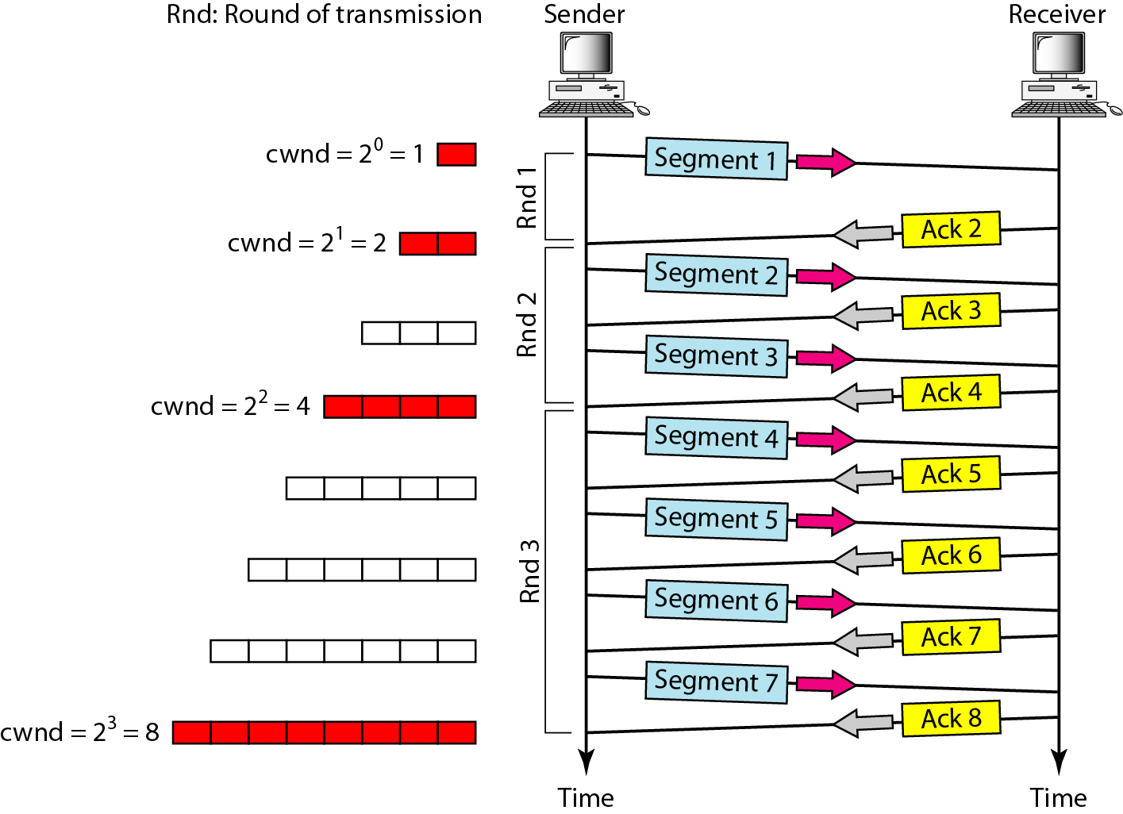
Slow Start- Exponential Increase

Slide 25
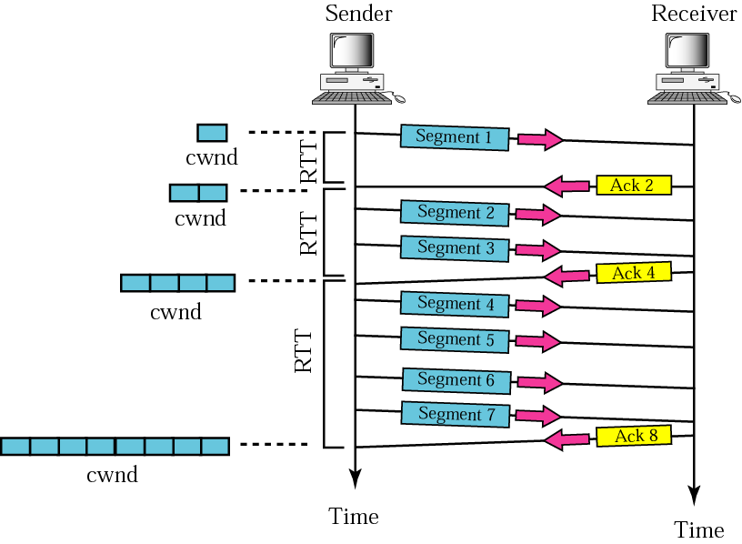
Slow Start- Exponential Increase
MSS (max. segment size)

Slide 26
Slow Start- Exponential Increase
Assumptions:
rwnd>cwnd , so sender window=cwnd
Each segment 1 byte
Each segment is acknowledged individually*.
In the slow-start algorithm, the size of the congestion window increases exponentially until it reaches a threshold.

Slide 27
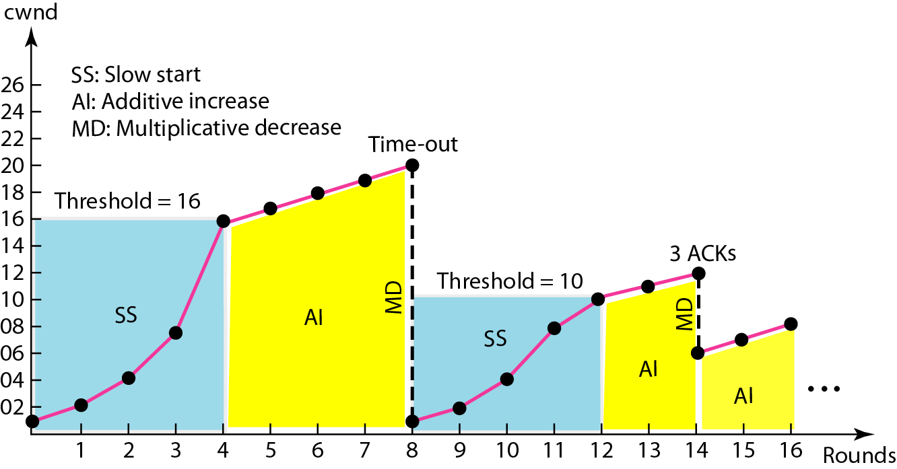
Slow Start
Sender keeps track of a variable named ssthresh.
When window reaches ssthresh the next phase starts.
Most implementation ssthresh is 65,535 bytes.

Slide 28
Congestion Avoidance:
In the congestion avoidance algorithm, the size of the congestion window increases additively until
congestion is detected.

Slide 29
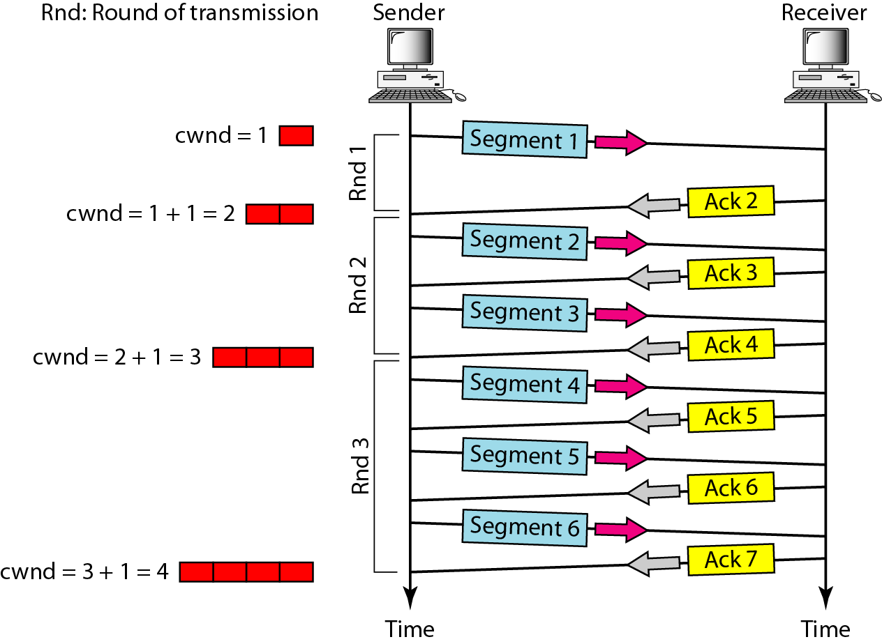
Congestion Avoidance:

Slide 30
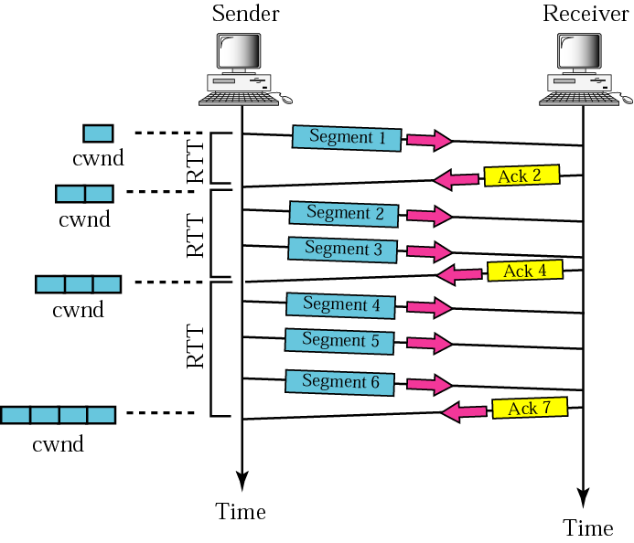
Congestion Avoidance:

Slide 31
Congestion Detection:
An implementation reacts to congestion detection in one of the following ways:
❏ If detection is by time-out, a new slow
start phase starts.
❏ If detection is by three ACKs, a new
congestion avoidance phase starts.

Slide 32
Congestion Detection:
Congestion detected by time-out (severe congestion)
  starts new slow start phase
  ssthresh = max(2, floor(cwnd/2))
  cwnd=1
Congestion detected by three ACKs (less severe congestion)
  starts new congestion avoidance phase
  ssthresh = max(2, floor(cwnd/2))
  cwnd= ssthresh

Slide 33
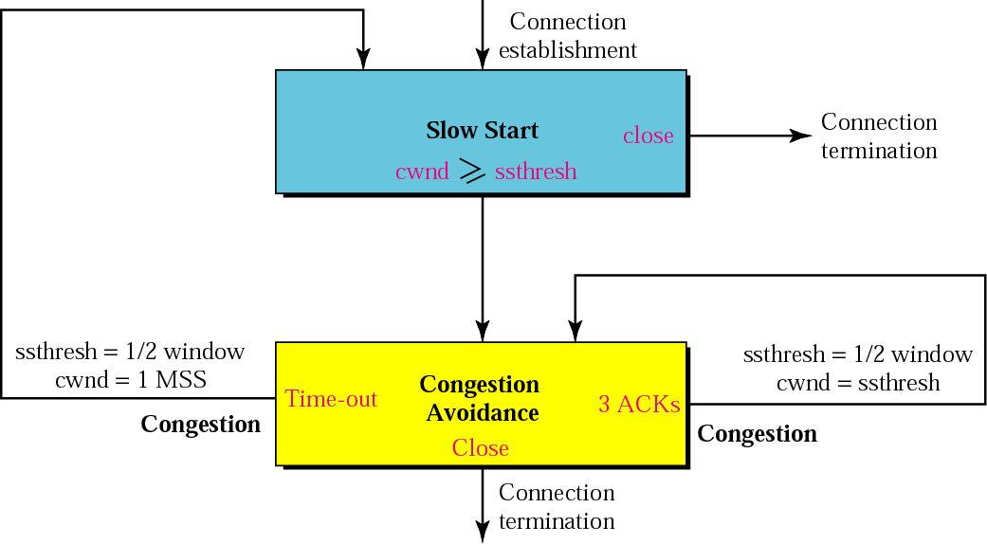
TCP Congestion Policy:

Slide 34
TCP Congestion Example:

Slide 35
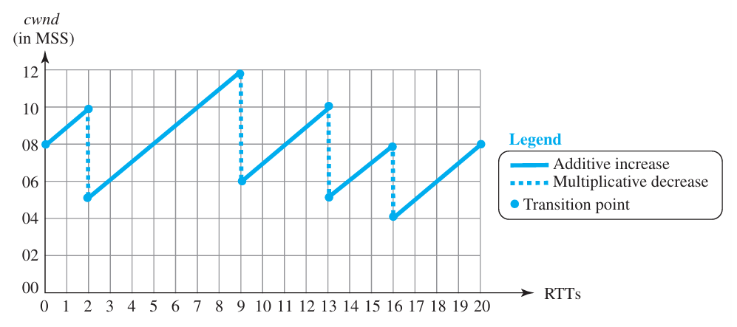
AIMD: Additive Increase Multiplicative Decrease

Slide 36
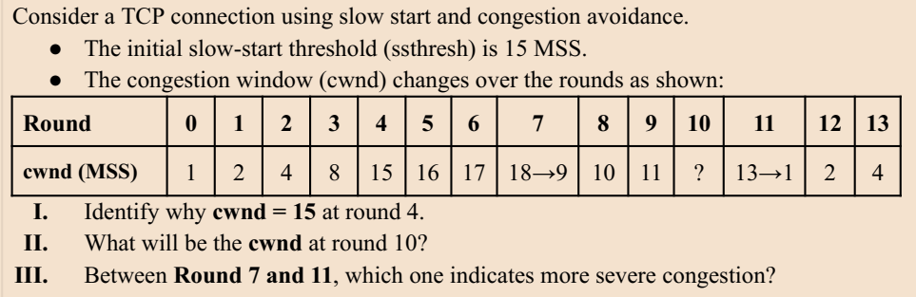
Cwnd touches the threshold
12
11 as timeout occurs on this round

Slide 37
A file transfer starts at cwnd=1 MSS; ssthresh=9; round=0. The system faces a time-out at
around 6 and then a 3-dup-ack on round 11.
  Identify the cwnd size on round 15.
  Identify the ssthresh on round 15.
  Total of how many bytes were successfully sent till round 15 if each MSS held 3 bytes of data?
Round | 0 | 1 | 2 | 3 | 4 | 5 | 6 | 7 | 8 | 9 | 10 | 11 | 12 | 13 | 14 | 15 | 16
cwnd | 1 | 2 | 4 | 8 | 9 | 10 | 11->1 | 2 | 4 | 5 | 6 | 7->3 | 4 | 5 | 6 | 7
Ssthresh=3
Ssthresh=5
Cwnd on round 15: 7
Ssthresh on round 15: 3
Total bytes upt to round 15: 3*(1+2+4+8+9+10+1+2+4+5+6+3+4+5+6+7)

Slide 39
The End

